Slide 1




A Complete Guide to Programming in C++
Chapter 11 – Storage Classes and Namespaces

Slide 2

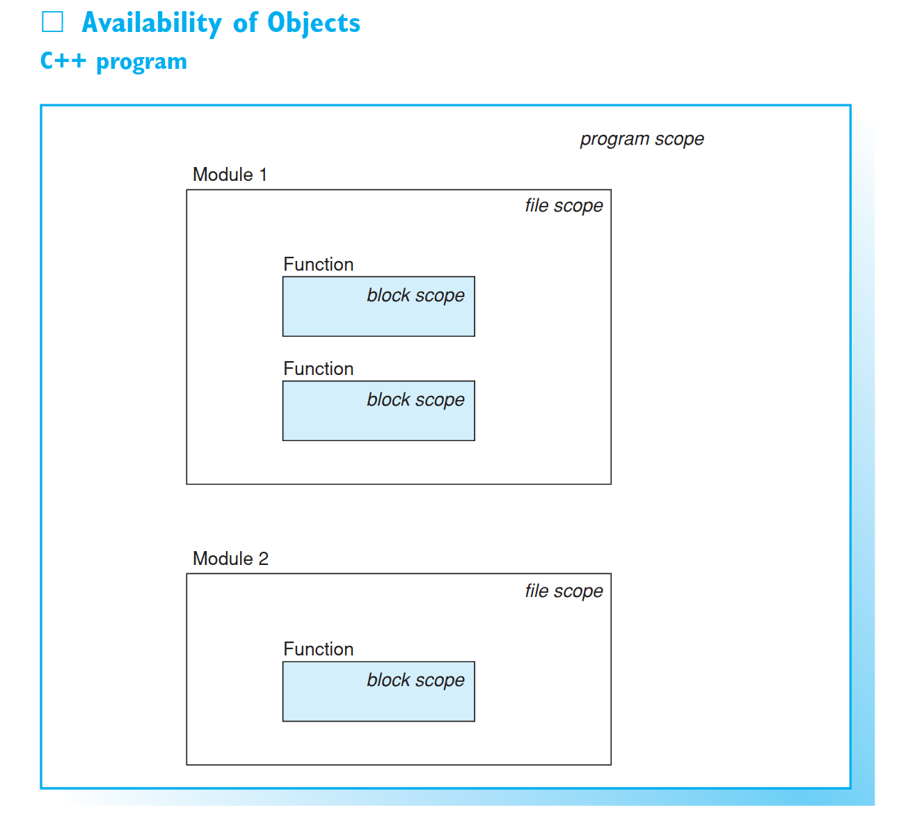
Storage classes of objects
This chapter begins by describing storage classes for objects and functions. The storage class is responsible for defining those parts of a program where an object or function can be used. Namespaces can be used to avoid conflicts when naming global identifiers.

Slide 3
Storage Class Specifiers
The storage class of an object is determined by
the position of its declaration in the source file
the storage class specifier, which can be supplied optionally.
The following storage class specifiers can be used
extern static auto register
When an object is declared, not only are the object’s type and name defined but also its storage class. The storage class specifies the lifetime of the object, that is, the period of time from the construction of the object until its destruction. In addition, the storage class delimits the part of the program in which the object can be accessed directly by its name, the so-called object scope.

Slide 4
Storage Class Specifiers
Essentially, an object is only available after you have declared it within a translation unit. A translation unit, also referred to as module, comprises the source file you are compiling and any header files you have included. As a programmer, you can define an object with:
block scope - The object is only available in the code block in which it was defined. The object is no longer visible once you have left the code block.
file scope - The object can be used within a single module. Only the functions within this module can reference the object. Other modules cannot access the object directly.
program scope - The object is available throughout the program, providing a common space in memory that can be referenced by any pro- gram function. For this reason, these objects are often referred to as global.
Access to an object as defined by the object’s storage class is independent of any access controls for the elements of a class. Namespaces that subdivide program scope and classes will be introduced at a later stage.

Slide 5
Lifetime
Objects with block scope are normally created automatically within the code block that defines them. Such objects can only be accessed by statements within that block and are called local to that block. The memory used for these objects is freed after leaving the code block. In this case, the lifetime of the objects is said to be automatic.
However, it is possible to define objects with block scope that are available through- out the runtime of a program. The lifetime of these objects is said to be static. When the program flow re-enters a code block, any pre-existing conditions will apply.
Objects with program and file scope are always static. These objects are created when a program is launched and are available until the program is terminated.
Four storage classes are available for creating objects with the scope and lifetime you need. These storage classes will be discussed individually in the following sections.

Slide 6
The storage class extern
If an object is not defined within a function, it belongs to the extern storage class. Objects in this storage class have program scope and can be read and, provided they have not been defined as const, modified at any place in the program. External objects thus allow you to exchange information between any functions without passing any arguments.
EXAMPLE: A filter to remove white-space characters at the ends of lines
The string line, which has a global definition, is used to exchange data.
Global objects that are not explicitly initialized during definition receive an initial value of 0 (that is, all bits = 0) by default. This also applies to objects belonging to class types, if not otherwise stipulated by the class.

Slide 7
Using Global Objects
An object belonging to the extern storage class is initially only available in the source file where it was defined. If you need to use an object before defining it or in another module, you must first declare the object. If you do not declare the object, the compiler issues a message stating that the object is unknown. The declaration makes the name and type of the object known to the compiler.
In contrast to a definition, the storage class identifier extern precedes the object name in a declaration.

Slide 8
Using Global Objects
This statement declares position as an external object of type long. The extern declaration thus allows you to “import” an object from another source file.
A global object must be defined once, and once only, in a program. However, it can be declared as often as needed and at any position in the program. You will normally declare the object before the first function in a source file or in a header file that you can include when needed. This makes the object available to any functions in the file. Remember, if you declare the object within a code block, the object can only be used within the same block.
An extern declaration only refers to an object and should therefore not be used to initialize the object. If you do initialize the object, you are defining that object!

Slide 9
The storage class static
If an object definition is preceded by the static keyword, the object belongs to the static storage class.
Example: static int count;
The most important characteristic of static objects is their static (or permanent) lifetime. Static objects are not placed on the stack, but are stored in the data area of a program just like external objects.

Slide 10
The storage class static
However, in contrast to external objects, access to static objects is restricted. Two conditions apply, depending on where the object is defined:
1. Definition external to all program functions In this case, the object is external static, that is, the object can be designated using its name within the module only, but will not collide with any objects using the same name in other modules.
2. Definition within a code block This means that the object is internal static, that is, the object is only visible within a single block. However, the object is created only once and is not destroyed on leaving the block. On re-entering the block, you can continue to work with the original object.
The same rules apply to initializing static objects as they do to external objects. If the object is not initialized explicitly, a default value of 0 applies.

Slide 11
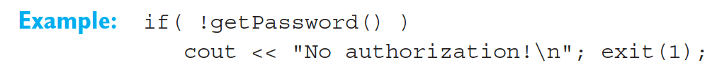
Example:
The function getPassword() checks a password that is entered. Permission is refused following three unsuccessful attempts or when 60 seconds have elapsed. You could use the following instructions to call the function in another source file:
The string secret and the thresholds maxcount and maxtime are external static, whereas the variable sec in the function timediff() is internal static. Its value is zero only when the function is first called. It makes sense to add a further function to these source files providing for password changes.

Slide 12
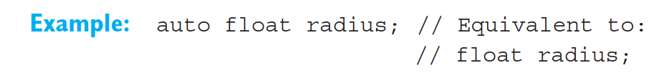
The Specifiers auto and register
The storage class auto (automatic) includes all those objects defined within a function but without the static keyword. The parameters of a function are also auto objects. You can use the auto keyword during a definition.
When the program flow reaches the definition, the object is created on the stack, but in contrast to a static type object, the object is destroyed on leaving the block.
auto objects have no specific initial value if they are not initialized explicitly. However, objects belonging to a class type are normally initialized with default values, which can be specified in the class definition.

Slide 13
Using CPU Registers
To increase the speed of a program, commonly used auto variables can be stored in CPU registers instead of on the stack. In this case, the register keyword is used to declare the object.
A register is normally the size of an int variable. In other words, it only makes sense to define register variables if the variable is not too large, as in the case of types such as char, short, int or pointers. If you omit the type when defining a register variable, an int is assumed.
However, the compiler can ignore the register keyword. The number of registers available for register variables depends on your hardware, although two registers are nor- mally available. If a program defines too many register variables in a code block, the superfluous variables are placed in the auto storage class.

Slide 14

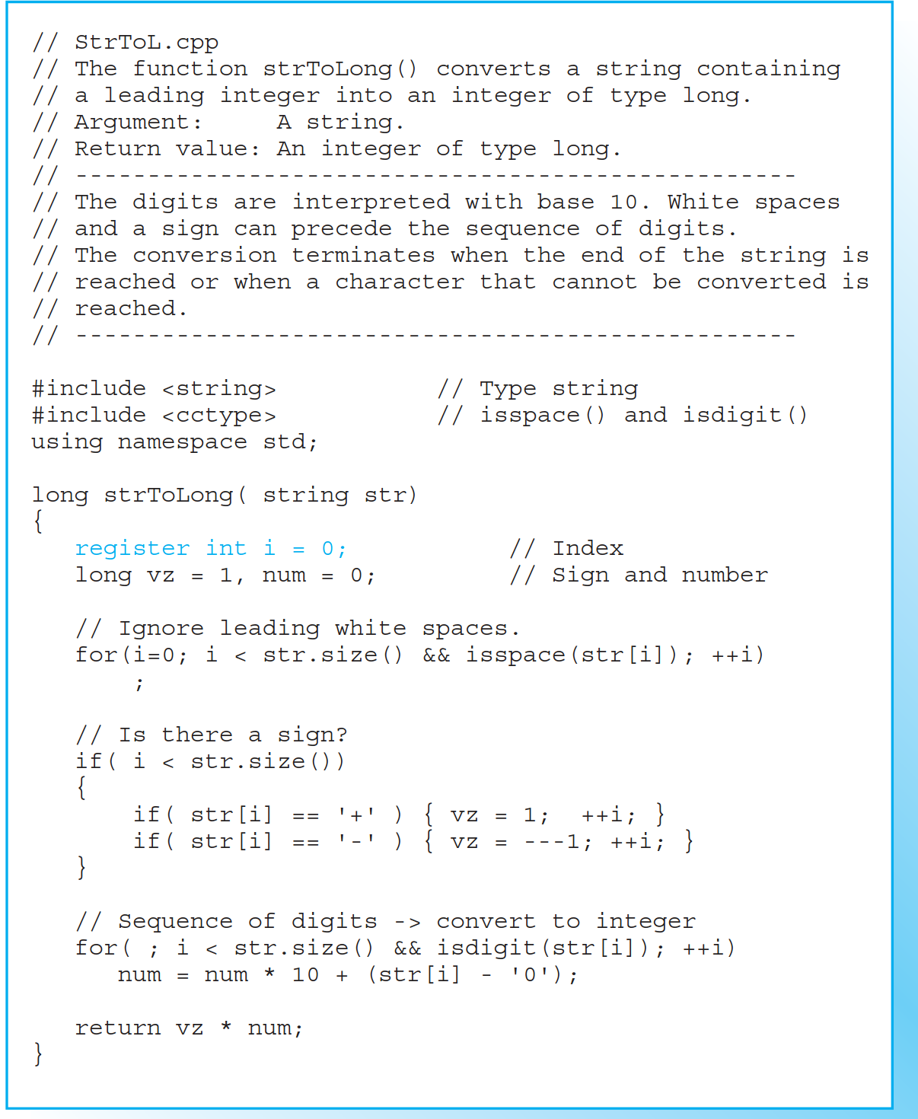

Sample Function
The function strToLong() illustrates an algorithm that converts a sequence of digits to a binary number. This is useful if you need to perform calculations with a number contained in a string.
The algorithm using the string "37" and the long variable num: Step 0: num = 0; Step 1: 1st character '3' → number 3 = ('3'-'0') num = num * 10 + 3; // = 3 Step 2: 2nd character '7' → number 7 = ('7'-'0') num = num * 10 + 7; // = 37
This pattern is followed for every number in a longer string.

Slide 15
The Storage Classes of Functions
Only two storage classes are available for functions: extern and static. Functions with block scope are invalid: you cannot define a function within another function.
The storage class of a function defines access to the function, as it does for an object. External functions have program scope, whereas static functions have file scope.

Slide 16
External Functions
If the keyword static is not used when defining a function, the function must belong to the extern storage class.
In a similar manner to external objects, external functions can be used at any position in a program. If you need to call a function before defining it, or in another source file, you will need to declare that function.
As previously seen, you can omit the extern keyword, since functions belong to the extern storage class by default.

Slide 17
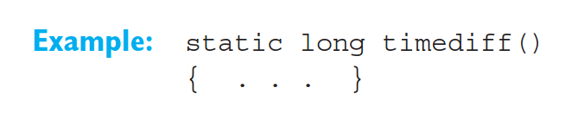
Static Functions
To define a static function, simply place the keyword static before the function header.
Functions in the static storage class have “private” character: they have file scope, just like external static objects. They can only be called in the source file that defines them. The name of a static function will not collide with objects and functions of the same name in other modules.
If you need to call a static function before defining it, you must first declare the function in the source file.

Slide 18
Namespaces
Using global names in large-scale software projects can lead to conflicts, especially when multiple class libraries are in operation.
C++ provides for the use of namespaces in order to avoid naming conflicts with global identifiers. Within a namespace, you can use identifiers without needing to check whether they have been defined previously in an area outside of the namespace. Thus, the global scope is subdivided into isolated parts.
A normal namespace is identified by a name preceded by the namespace keyword. The elements that belong to the namespace are then declared within braces.

Slide 19
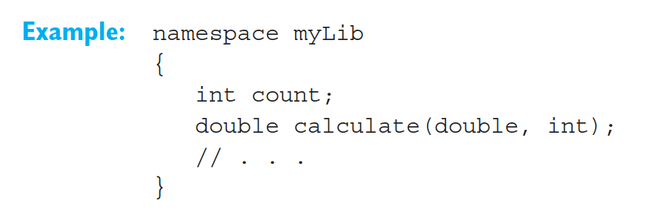
Namespaces
This example defines the namespace myLib that contains the variable count and the function calculate().
Elements belonging to a namespace can be referenced directly by name within the namespace. If you need to reference an element from outside of the namespace, you must additionally supply the namespace. To do so, place the scope resolution operator, ::, before the element name.

Slide 20
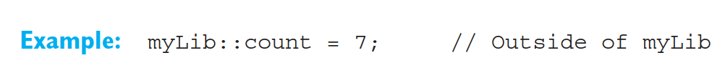
Namespaces
This allows you to distinguish between identical names in different namespaces. You can also use the scope resolution operator :: to reference global names, that is, names declared outside of any namespaces. To do so, simply omit the name of the namespace. This technique is useful when you need to access a global name that is hidden by an identical name defined in the current namespace.

Slide 21
Namespaces
Be aware of the following when using namespaces:
namespaces do not need to be defined contiguously. You can reopen and expand a namespace you defined previously at any point in the program
namespaces can be nested, that is, you can define a namespace within another namespace
Global identifiers belonging to the C++ standard library automatically belong to the standard namespace std.
EXAMPLE: Defining and testing namespaces.

Slide 22
The Keyword using
You can simplify access to the elements of a namespace by means of a using declaration or using directive. In this case, you do not need to repeatedly quote the namespace.
Just like normal declarations, using declarations and using directives can occur at any part of the program.

Slide 23

Using Declarations
A using declaration makes an identifier from a namespace visible in the current scope.
You can then call the function calculate() from the myLib namespace.
This assumes that you have not previously used the name calculate in the same scope.

Slide 24

Using Directive
The using directive allows you to import all the identifiers in a namespace.
This statement allows you to reference the identifiers in the myLib namespace directly. If myLib contains an additional namespace and a using directive, this namespace is also imported.
If identical identifiers occur in the current namespace and an imported namespace, the using directive does not automatically result in a conflict. However, referencing an identifier can lead to ambiguities. In this case, you should use the scope resolution opera- tor to resolve the situation.

Slide 25
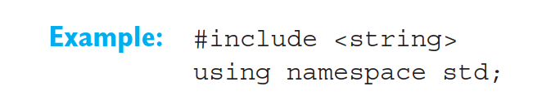
Using Directive
C++ header files without file extensions are used to declare the global identifiers in the standard namespace std. The using directive was used in previous examples to import any required identifiers to the global scope:
When developing large-scale programs or libraries, it is useful to declare the elements of any proprietary namespaces in header files. Normal source files are used to define these elements.
EXAMPLE: Demonstrating the use of using-declarations and using-directives

